Slide 1
Week 11

Slide 2
Updates - Quiz / Final Schedule
Quiz 4 answer key
https://github.com/pattonsgirl/Fall2021-CEG2350/blob/main/Quizzes/Quiz4.md
Quiz 5 - 11/18
Quiz 6 - 12/2
Final - 12/7

Slide 3
Updates - Lab Schedule
Lab 08 - 11/8 - processes
Lab 09 - 11/15 - code
Lab 10 - 11/22 - networking
Lab 11 - 12/3 (Friday before finals) - systems stuff / random
Lab redos - 12/10
07 - 11

Slide 4
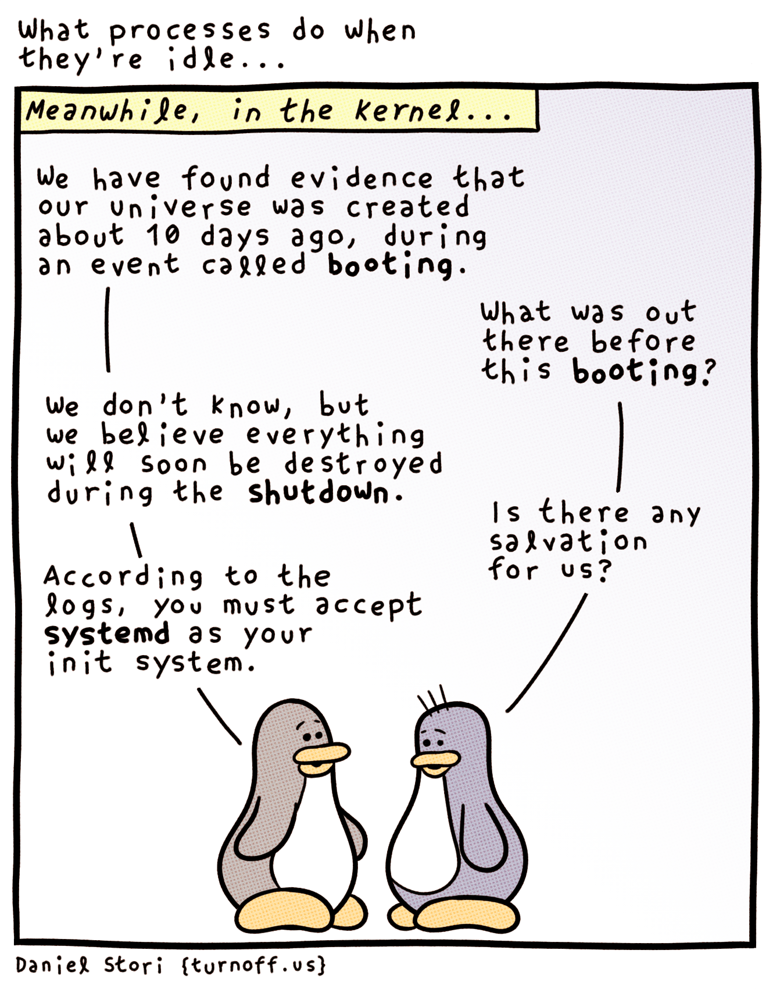
Notes:
http://turnoff.us/geek/idle/

Slide 5
In the beginning there was kernel
$ dmesg
The startup messages from kernel (since we can’t see them live)
$ cat /proc/cmdline – how the kernel is called to start (+ parameters)
Kernel (once started) is doing the following:
CPU inspection
Memory inspection
Device bus discovery
Device discovery
Setup auxiliary systems (networking, etc.)
Mount root filesystem
Start userspace (start the init process)

Slide 6
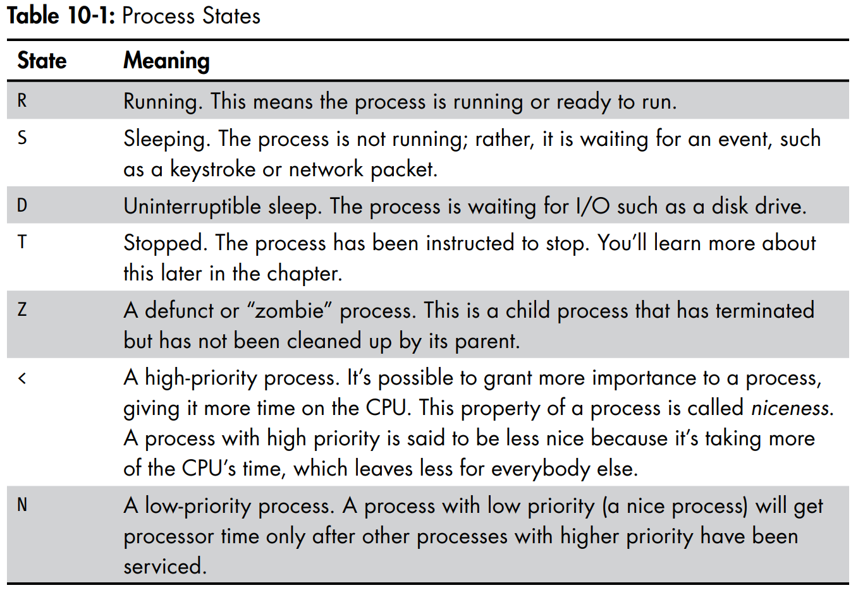






Process States
Notes:
Linux Command line pg 132

Slide 7





System Calls you know
In a program:
Reading files
Write content to files
File openers, file descriptors, etc.
Using a program:
Getting multiple instances of the same thing
I can open many word documents
I can make many SSH connections to the AWS system
These are unique processes that can operate independent of eachother

Slide 8


System Calls
programmatic way in which a computer program requests a service from the kernel of the operating system it is executed on
fork
A parent process uses fork to create a new child process. The child process is a copy of the parent. After fork, both parent and child executes the same program but in separate processes.
exec
Replaces the program executed by a process. The child may use exec after a fork to replace the process’ memory space with a new program executable making the child execute a different program than the parent.
exit
Terminates the process with an exit status.
wait
The parent may use wait to suspend execution until a child terminates. Using wait the parent can obtain the exit status of a terminated child.
Notes:
https://www.geeksforgeeks.org/introduction-of-system-call/

Slide 9
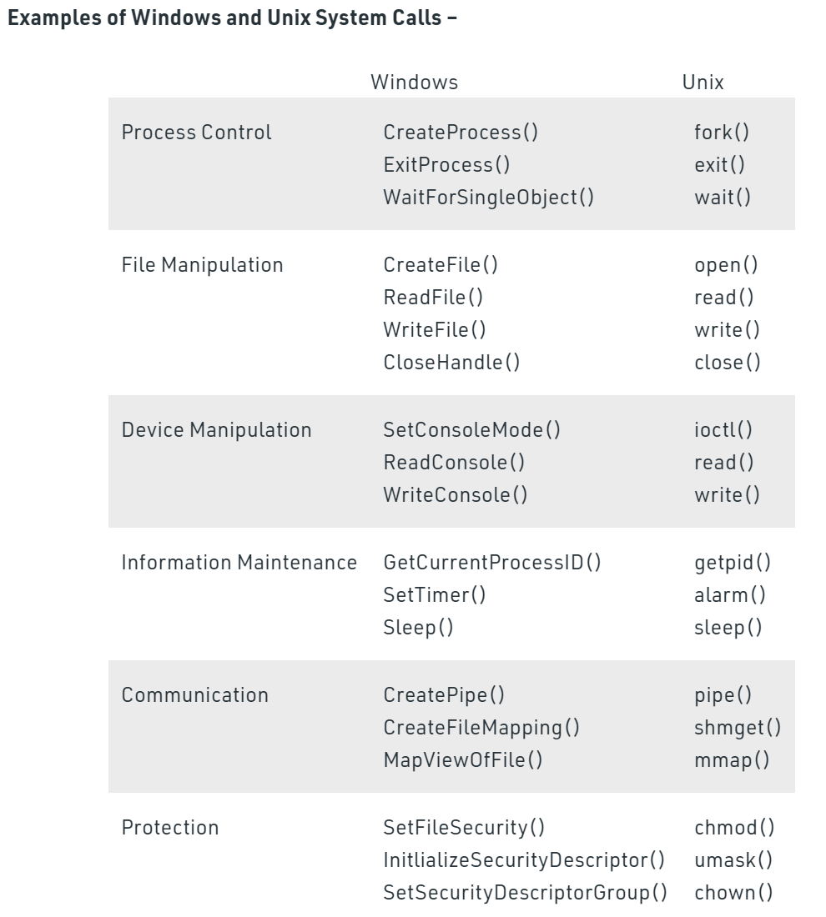
System Calls to note
Notes:
https://www.geeksforgeeks.org/introduction-of-system-call/
https://www.guru99.com/system-call-operating-system.html

Slide 10
Process control resources
https://www.guru99.com/system-call-operating-system.html
http://www.it.uu.se/education/course/homepage/os/vt18/module-2/process-management/
https://www.geeksforgeeks.org/difference-between-process-parent-process-and-child-process/
http://www.cs.iit.edu/~cs561/cs450/fork/fork.html
https://github.com/pattonsgirl/Fall2021-CEG2350/tree/main/processes

Slide 11





Zombies and Orphans
Zombie:
A terminated process is said to be a zombie or defunct until the parent does wait on the child.
A child process always first becomes a zombie.
In most cases, under normal system operation zombies are immediately waited on by their parent.
Orphan:
Parent process terminated, child had not terminated yet
All processes must have parents
Will be adopted by the init process (PID 1) and terminated

Slide 12









Fork vs Thread
Fork – its own copy of the process
Processes can communicate over network channel / pipe
Thread – works inside the process (multi-threaded)
Share resources and memory of process
Kernel schedule and runs threads like processes
Threads can run simultaneously on multiple processers
More efficient for thread to intercommunicate
$ ps m #dashes indicate thread of process
Have a thread id
$ ps m –o pid,tid,command
Notes:
https://users.cs.cf.ac.uk/Dave.Marshall/C/node32.html
https://www.tutorialspoint.com/multithreading-in-c

Slide 13
Playing with Processes

Slide 14

Joke

Slide 15
Kill-ing and kill signals
CTRL + C
CTRL + Z
$ kill PID
$ kill SIGNAL PID

Slide 16
Executing a process
Where does it go?
source
When you source the script you are typing the commands in your current shell. Any changes to the environment will take effect and stay in your current shell.
./ or by name
When you execute the script you are opening a new shell, type the commands in the new shell, copy the output back to your current shell, then close the new shell. Any changes to environment will take effect only in the new shell and will be lost once the new shell is closed.
Notes:
https://superuser.com/questions/176783/what-is-the-difference-between-executing-a-bash-script-vs-sourcing-it

Slide 17
Background / foreground control
Processes are tied to the terminal they are running in
Start a process in the background by putting & at the end of command
See running jobs with: jobs
Jobs id != PID
Stop with `kill %job_number`
Move to background:
Suspend (Ctrl + Z) + bg [job_number]
Move to foreground:
fg [%job_number]
Notes:
https://www.digitalocean.com/community/tutorials/how-to-use-bash-s-job-control-to-manage-foreground-and-background-processes

Slide 18
Running in background
- [How To Use Bash's Job Control to Manage Foreground and Background Processes](https://www.digitalocean.com/community/tutorials/how-to-use-bash-s-job-control-to-manage-foreground-and-background-processes)
- [Understanding foreground and background Linux processes](https://linuxconfig.org/understanding-foreground-and-background-linux-processes)

Slide 19
Screen
Screen – virtual terminals
Lazy way out of process management
Create a screen called test-session: $ screen –S test-session
List screens: $ screen –ls
Send commands: ctrl + a [corresponding option]
Detach: Ctrl + a d
Kill: Ctrl + a k
Resume screen: $ screen –r screen_number_from_ls
Notes:
https://www.tecmint.com/screen-command-examples-to-manage-linux-terminals/

Slide 20
Running in screen
[How to Use Linux Screen Command](https://www.howtogeek.com/662422/how-to-use-linuxs-screen-command/)
[Kill detached screen session](https://www.baeldung.com/linux/kill-detached-screen-session)

Slide 21
Pick up here
Working zombie
Zombies: child processes that are done and need cleaned up
Orphans: parent process finished first, no one to clean up child, gets adopted by init

Slide 22




Role of the Kernel
Main memory (think RAM) – where kernel & processes reside
IO flows through main memory
CPU operates on main memory
Kernel:
Keeps track of memory (what is shared, what is allocated, what is free)
Handles which processes access the CPU and when
Interfaces between hardware and processes
Processes communicate with the kernel, kernel tracks “state” info
Look at /proc/

Slide 23


Process Management
Start / stop / resume / terminate a process
User side, processes look like they are running simultaneously
In case of single core CPU
Kernel manages giving one process CPU access at a time
Managing ongoing ssh connection and dealing with my input while dealing with everything else

Slide 24





Context Switching
Once CPU time slice for a current process is over
CPU interrupts current process
Kernel records state of CPU & memory (so process can resume)
Kernel picks another process in the queue, preps memory & CPU
Kernel assigns time slice for new process
Control of process given to CPU
Other kernel jobs, like collecting keyboard input, happen during this process transition (in between CPU time slices)

Slide 25
Single CPU Multitasking
Single CPU = hardware single core or a core within the hardware
Happens via time slicing – each process gets a turn, looks seamless to user - context switching

Slide 26










Symmetric Multiprocessing CPUs
SMP = Symmetric Multiprocessing
How multiple CPUs communicate
Multiple processors share a common memory & OS
Each CPU has its own cache
CPUs to main memory all share one bus
Each processor can be assigned a process
Idea can be replicated for multi-core CPUs
Notes:
https://www.tutorialspoint.com/Symmetric-Multiprocessing
https://www.ibm.com/developerworks/library/l-linux-smp/index.html

Slide 27
















Slide 28














Slide 29
Hyperthreading CPUs
Hyper-threading – Intel branded term for simultaneous multithreading (SMT)
CPU splits physical cores into virtual cores, which are known as threads
Standard is one core = two threads ratio
Allows each core to do two things simultaneously
If one is waiting, other logical CPU can take resources
When looking at system specs, logical cores will be listed same as only physical would
Core is capable of executing two sets of instructions in the same clock cycle
Notes:
https://jogendras.wordpress.com/2018/02/26/how-can-a-single-core-processor-run-multiple-tasks-at-once/

Slide 30




Process Scheduling
Priority Scheduling
Earliest deadline first (EDF) or least time to go
Whenever a scheduling event occurs (a task finishes, new task is released, etc.), the queue will be searched for the process closest to its deadline, which will be the next to be scheduled for execution.
Pre-emptive (fixed priority)
Fixed priority rank to every process
Scheduler arranges the processes in the ready queue in order of their priority. Lower-priority processes get interrupted by incoming higher-priority processes
Notes:
https://en.wikipedia.org/wiki/Scheduling_(computing)#Scheduling_disciplines

Slide 31

Linux: Changing Niceness
Setting niceness
$ renice [-20 : 20] PID
Niceness usually set to 0
Can “bully” processes out of a natural turn taking order

Slide 32




Memory Management
Kernel has its own protected memory (kernel space)
In user space (post init world):
Each process needs its own section of memory
Some processes may not access another process’s memory
Some memory is read only (file permissions)
System can use more memory by using disk space as an offset (virtual memory - swap & paging)

Slide 33














Slide 34


How Memory Access Works
MMU (memory management unit) [on CPU] + kernel
Kernel breaks process’s memory into smaller chunks (pages)
Kernel maintains page table
maps virtual addresses to physical (combo of RAM and swap space)
On-demand paging
Kernel loads & allocates pages as process needs them

Slide 35







Page Faults
Memory page is not ready when process wants to use it
Kernel takes control from CPU, works to get page
Minor page fault
Desired page is in main memory, MMU doesn’t know where it is
MMU can only remember so many locations at once
Process needs more memory
Kernel finds free pages / makes room
Major page fault
Desired page isn’t in main memory.
Kernel needs to fetch from disk

Slide 36






Watching page faults
$ /usr/bin/time cal > /dev/null
$ ps -o pid,min_flt,maj_flt PID

Slide 37
Processes
Linux Command Line
Ch10
Pg. 130

Slide 38
Just Powershell Things
> Get-Process
> WMIC # enter shell like environment for wmi commands
CPU
Returns all the things about the host system CPU
> wmic process call create notepad.exe
> Get-WmiObject win32_process -Filter “name = ‘notepad.exe’”
Notes:
https://docs.microsoft.com/en-us/powershell/module/microsoft.powershell.management/get-process?view=powershell-7.1

Slide 39
Murdering Processes with WMI
(Get-WmiObject win32_process -Filter “name = ‘notepad.exe’”).Terminate()
https://devblogs.microsoft.com/scripting/learn-four-ways-to-kill-a-process-using-powershell-and-wmi/

Slide 40
Kernel Reads
Deeper dive into Linux Kernel
https://en.wikipedia.org/wiki/Linux_kernel
Architecture of Windows NT kernel
https://en.wikipedia.org/wiki/Architecture_of_Windows_NT
Comparison of most kernels (who supports what)
https://en.wikipedia.org/wiki/Comparison_of_operating_system_kernels
Monolithic vs Hybrid Kernels:
https://en.wikipedia.org/wiki/Monolithic_kernel
https://en.wikipedia.org/wiki/Hybrid_kernel

Slide 41

Notes:
https://git-scm.com/book/en/v2/Git-Branching-Branches-in-a-Nutshell
https://git-scm.com/book/en/v2/Git-Branching-Basic-Branching-and-Merging

Slide 42
Git connections
Clone is a snapshot of a repository
Creates local copy that you can edit, add to
Commits can be made just on local
Commits are snapshots of the content changed
`push` and `pull` are the communication methods to remote (GitHub)
$ git remote –v
Where local has connection to.
Note fetch, push

Slide 43

















Slide 44
What is a branch?
When a repo is created, so is the main / master branch
Note: you can manually create a repo with $ git init repo_name.git
Each commit creates a “content changed” snapshot.
HEAD is a pointer to where you are in space
Usually points to latest commit (unless you need to go back in time)
$ git branch testing
Creates new branch based where you are in repo (usually up to date)
$ git checkout testing
Switches HEAD to branch
Add & commit work

Slide 45






Slide 46
When to branch
Developing a new feature
Patching a bug
Test out rabbit holes
All without affecting the master branch

Slide 47
Branch Merging
Cont. from previous slide
$ git checkout master
Moves HEAD to last commit on master
Working directory is not “up to date” with branch content
State before branch diverged
$ git merge testing
If no divergence work (conflicts) creates a commit that merges the branches
You can now delete the branch

Slide 48
Pushing a branch
Push involves the remote server
Remote server needs to know about locally created branches
$ git push --set-upstream origin testing
Now can push to the branch
Note: You could switch to master and merge the branch. Remote (GitHub) needs to know only if you are using something it isn’t aware of

Slide 49
Building your Git Skills
https://learngitbranching.js.org/?locale=en_US
https://ohmygit.org/
https://github.com/nivbend/gitstery
https://www.gitkraken.com/learn/git/tutorials
What does version control look like without git?
https://itoshkov.github.io/git-tutorial

